Slide 1

Team Details
Team Name: Syntax Squad
Team Members’ Name: Gurnoor Singh Saini
Abhay Rana
Lovedeep Kaur
Mohit Pant
College Name: GNA University

Slide 2
Problem Details
Problem Statement:
Wastage of human resources and fabric due to unfit clothes and accessories ordered online by people.
Problem Description:
When it comes to online shopping for clothes, getting the right fit can be a guessing game. Many people solve the quandary by ordering the same item in multiple sizes and then returning the ones that don’t fit. This leads to a lot of wastage of human resources and items required while for packing and shipping. Also returning items takes a lot of time, creates additional problems for shipping partners and delivery persons.

Slide 3
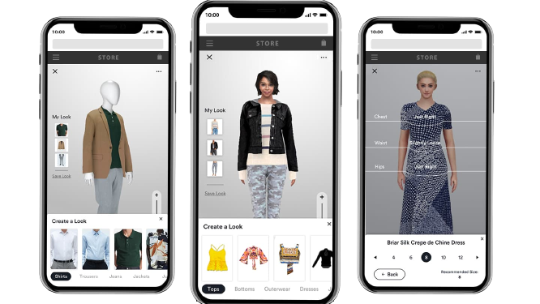
Solution/Approach Details
Creating an Augmented Reality app that finds clothes that truly fit to reduce wastage of human resources and fabric. The app uses facial and body recognition algorithms to define areas of the face and body and apply an overlay of selected products on areas.
* All Pictures shown are for illustration purpose only, original product might subject to change.

Slide 4
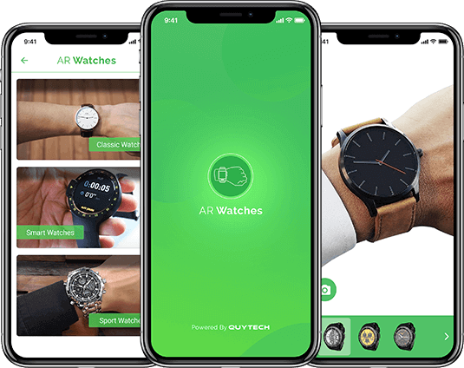
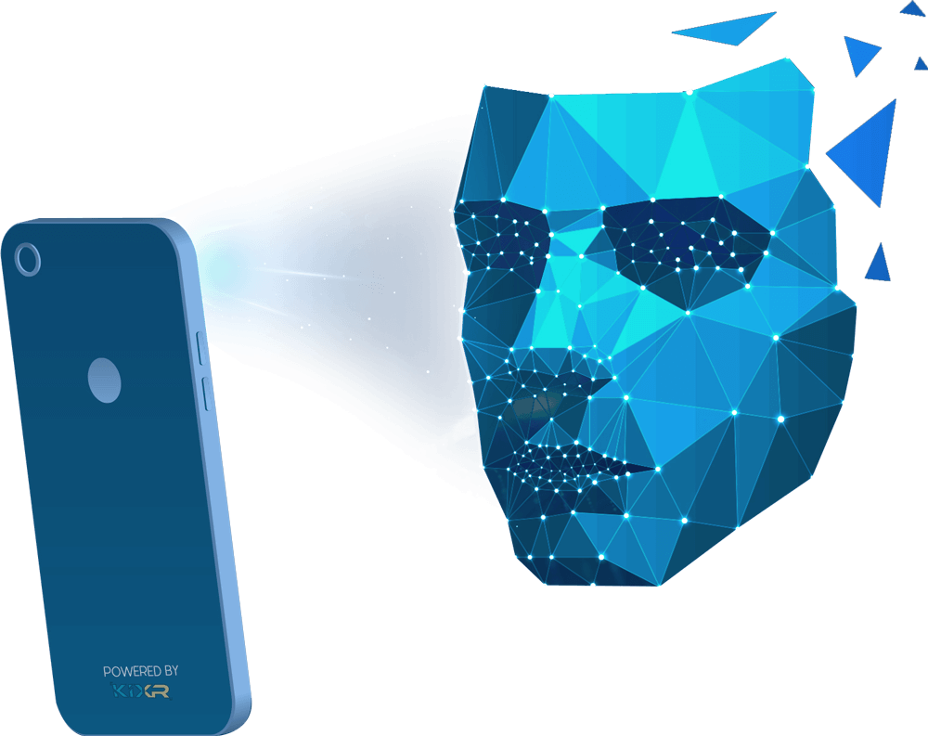
Solution/Approach Details
The application also takes measurements from customers and uses its machine-learning algorithm to fit the clothes to the 3-D model of the person and show how the clothing item would fit and look on the person. By letting customers try on products from the comfort of their home, brands can grow their sales and significantly decrease their return rates. Customers may imagine themselves in a range of styles and sizes before purchasing using AR clothing try-on technology, which helps to minimize expensive return rates dramatically.

Slide 5
Solution/Approach Details
Technology Stack:
Augumented Reality (Snap AR, Deep AR, Snapchat)
Artificial Intelligence
Python (python 3.xx, pytorch, openCV)
Blender
Android
Flutter (Flutter SDK, Flutter Flow, Dart)

